Slide 1
FEATURES OF JAVA
P. GEETHA MOUNIKA

Slide 2
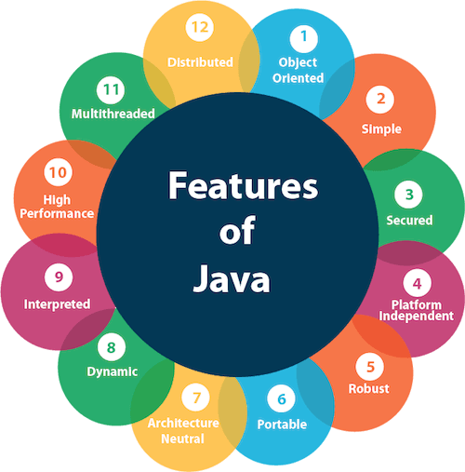

Slide 3
Platform Independence: Java Code Is Compiled Into Bytecode, Which Can Run On Any Device Equipped With The Java Virtual Machine (JVM), Making Java Applications Platform-independent.
Object-oriented: Java Follows An Object-oriented Programming Model, Which Helps In Organizing Complex Programs Into Reusable Objects And Classes.
Simple: Java's Syntax Is Clean And Easy To Understand, Inspired By C++, But With Fewer Low-level Complexities.
Secure: Java Provides A Secure Execution Environment Through Features Like Bytecode Verification, Sandboxing, And The Absence Of Explicit Pointers, Which Help Prevent Security Threats And Vulnerabilities.
Robust: Java Emphasizes Early Error Detection, Strong Memory Management Via Garbage Collection, And Exception Handling, Which Contribute To The Creation Of Robust Applications.

Slide 4
Multithreaded: Java Has Built-in Support For Multithreaded Programming, Allowing The Development Of Applications That Can Perform Multiple Tasks Simultaneously, Thereby Improving Performance.
Distributed: Java Provides Features For Building Distributed Applications Through Its Extensive Standard Library That Supports Protocols Like Rmi (Remote Method Invocation) And Corba (Common Object Request Broker Architecture).
High Performance: With Just-in-time (Jit) Compilers And Advanced Optimizations In The Jvm, Java Achieves High Performance, Even Though It Is An Interpreted Language.
Dynamic: Java Supports Dynamic Linking And Loading Of New Classes And Libraries, Enabling Applications To Adapt To Evolving Environments And Extend Their Functionality At Runtime.
Portable: Java's Portability Is Due To Its Architecture-neutral Bytecode And Consistent Behavior Across Different Platforms, Facilitated By The Jvm.

Slide 5
Architecture-neutral: The Java Bytecode Is Designed To Be Architecture-neutral, Making It Possible To Run The Same Java Program On Any Processor Architecture Without Modification.
Interpreted: Java Bytecode Is Interpreted By The Jvm, Which Allows For Platform Independence And Easy Debugging.
Automatic Memory Management: Java's Garbage Collection Automatically Manages Memory, Reclaiming Memory Used By Objects That Are No Longer Needed And Preventing Memory Leaks.
Rich Standard Library: Java Comes With An Extensive Standard Library (Java Api) That Provides A Wide Range Of Classes And Methods For Tasks Like Data Structures, Networking, Input/Output, Gui Development, And More.

